Slide 1
Gender gap on Wikipedia (and GitHub)
A report on developments and the status quo
by
Eva Jobst (51824341)
Mohammad Zandpour (01425603)

Slide 2
Discrimination in the tech industry
GitHub: 14 million users
Pull-request of females more often rejected
Why is that?

Slide 3
Discrimination in the tech industry
Wikipedia: largest encyclopedia of mankind
Most editors are male
Acceptance rating on articles about females is low

Slide 4
Implications?
Missing information leads to lack of content variety
Lack of content variety leads to bias
Bias leads to discrimination

Slide 5
Example: assistive devices
Home assistance: Alexa, Google Assistant, etc.
Apps: Siri, Cortana, etc.
Google search

Slide 6
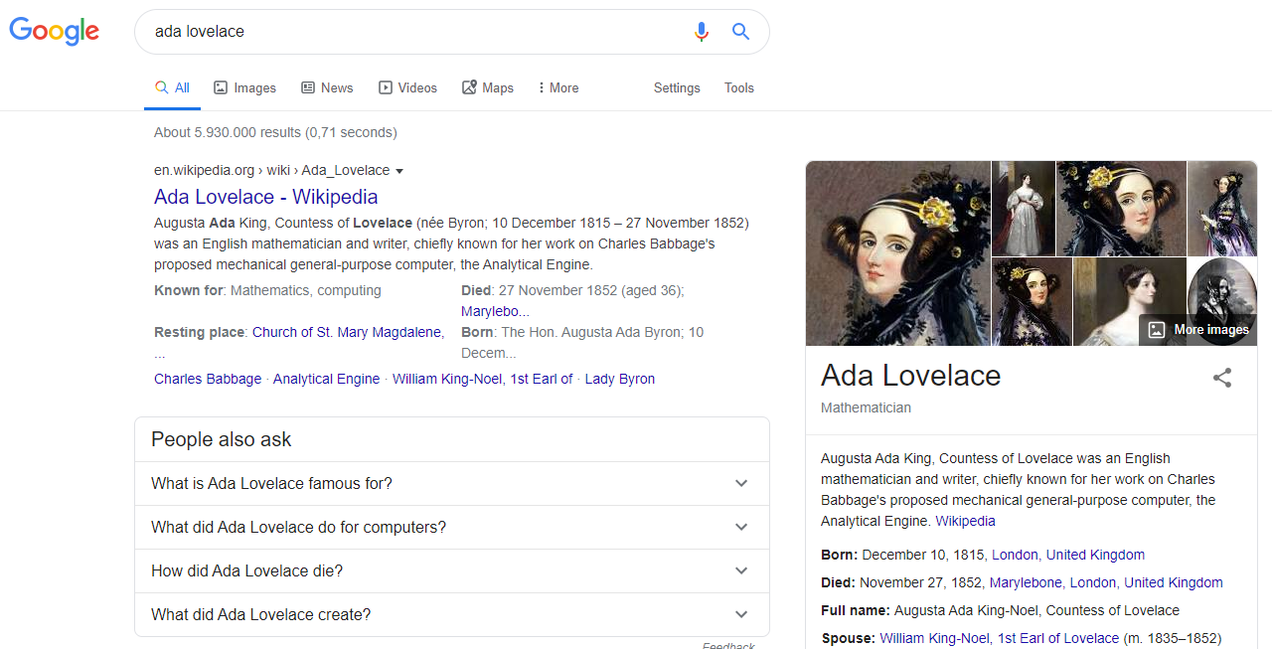

Slide 7
State of research interest
Systemic bias: academically recognized
New Media shift: Gender Gap is being researched in open source & open data

Slide 8
Considerations / Limitations
Most studies conducted in western world
Most studies are user studies
Not enough research on LGBTQ+ within Open Source / Open Data
We thus focused on the gender gap between male & female

Slide 9
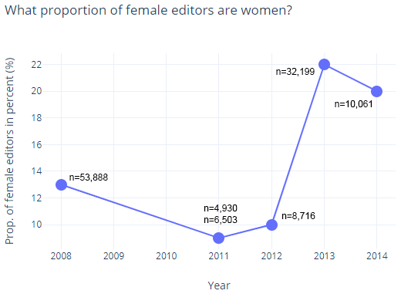
Wikipedia – Female editors
6 studies published 2008-2014 by Wikimedia Foundation
Strongest estimate: 22% of editors are women
Positive trend since 2011

Slide 10
Wikipedia – Self-perception
Helgeson et al.: difference between male & female self-perception & confidence
Why? Societal? Experiences?
Needs further research
Hinnosaar et al.: gender gap due to difference in self-perception
Because of Wikipedia or rather external influence?
Needs further research

Slide 11
Wikipedia – Conflicts with contributions
Lam et al:
Female newcomer-editors more likely to quit Wikipedia after their edits get reverted
Articles with females dominating the edits are significantly more often subject to heated debates
Conflicts → discomfort → demotivation → quitting

Slide 12
Wikipedia – Notability criteria
Wagner et al.: acceptance criteria often unfavorable towards women
Klein et al.: situation is getting considerably better
World is changing & it is reflected in Wikipedia

Slide 13
How to combat the gender gap on Wikipedia? WE SUGGEST
Be careful when reviewing edits of newcomers
Emphasize this in Wiki-guidelines
Thank users for their contributions → strengthen self-esteem
Encourage participation through female-focused info events

